Slide 1
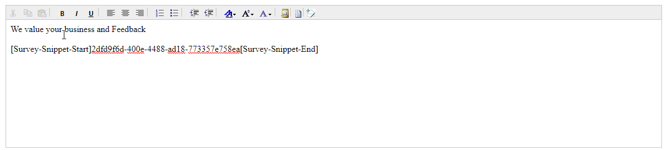
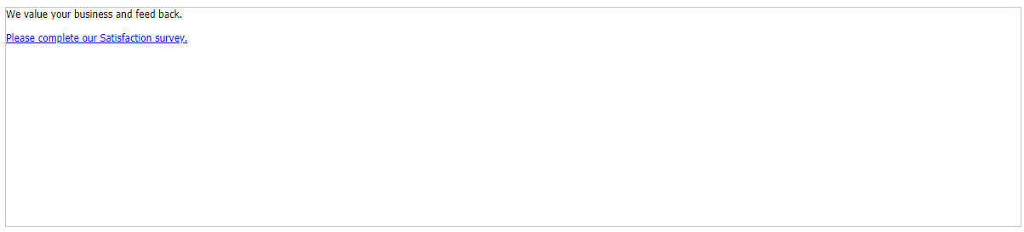
This is what an email containing the survey snippet looks like before sending.
Survey snippet replaced with link containing text defined in the survey link text.
This is what the respondent will see when they receive the survey invitation.

Slide 2









Automatically Distributing Survey Invites
Case status does not equal resolved
Nothing occurs workflow stopped
Survey invite clicked
Respondent completes survey
Case is closed
Resolved case survey invite workflow
Case status equals resolved
Survey invite sent

Slide 3
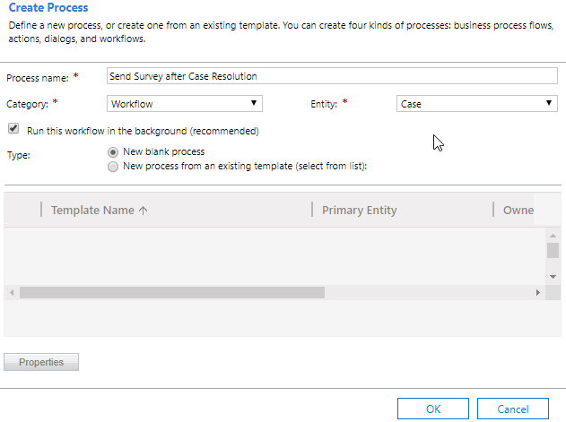
Specifies that the process is a workflow.
Based on the case entity since the survey will be sent after a case is resolved

Slide 4
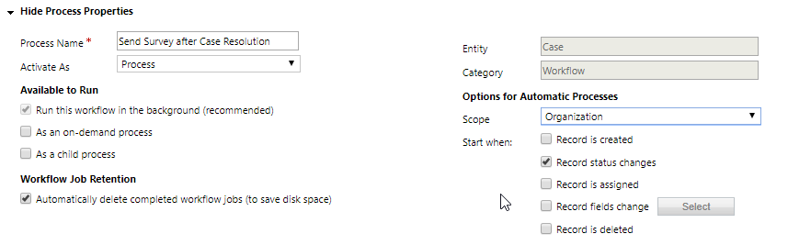
Setting scope to organization ensures it will apply to all cases.
Workflow should trigger anytime a case status changes.

Slide 5
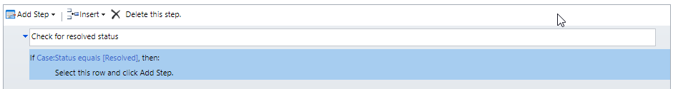
Workflow will only be applied to cases with a resolved status. All other case statuses will be ignored.

Slide 6
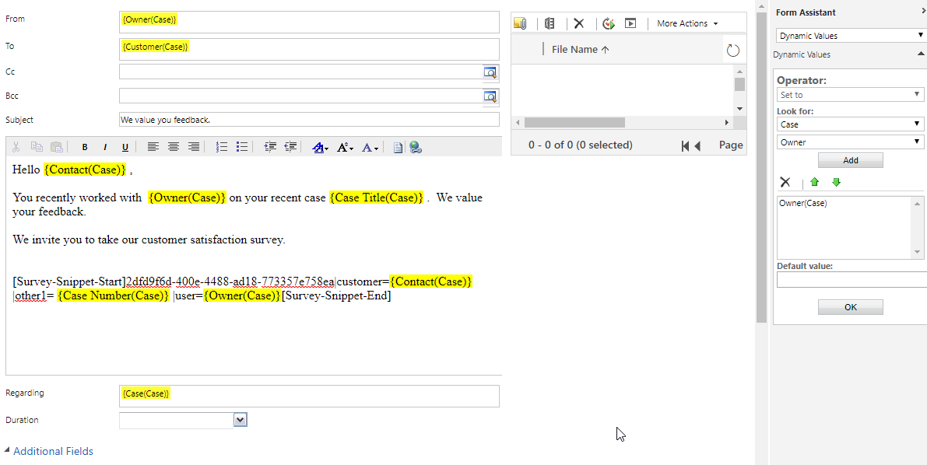
All values in yellow will be replaced with corresponding Dynamics 365 data.
Replaces the customer pipe with the contact associated with the case.
Replaces the user pipe with the agent that owns the case.
Replaces the other1 pipe with the case number.
Form Assistant is used to specify the Dynamics 365 values to use.

Slide 7
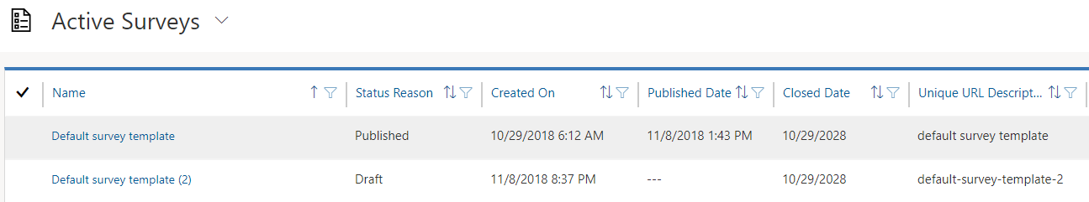
Cloned survey will have an integer appended to it. Survey will be in draft status

Slide 8
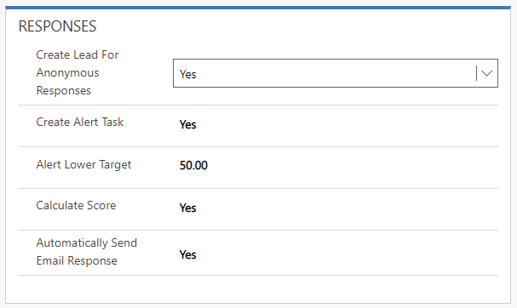
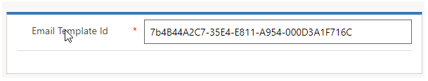
Will send automatic responses to non-anonymous respondents like accounts, contacts, and leads.
Template ID represents the guid of the template.

